Slide 1









Inventory Management

Slide 2


Introduction to Inventory Management
“Healthcare Inventory Management is a systematic process. It overseas and control the availability, storage, tracking and utilization of medical supplies, equipment and consumables within a healthcare facility”.
Low Inventory
Increase probability to stock out
Full Inventory- No stock out
Purpose of Inventory Control
Determine how much stock should be ordered/issued
Determine when stock should be ordered/issued
Maintain an appropriate stock level of all products, avoiding shortages and oversupply.

Slide 3
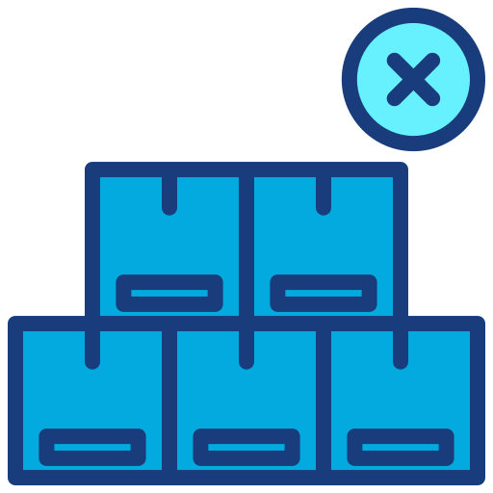



To avoid stock outs and shortages.
To avoid overstock (too much).
To ensure that medicine are efficiently utilized.
For planning and budgeting.
Why Inventory Management

Slide 4
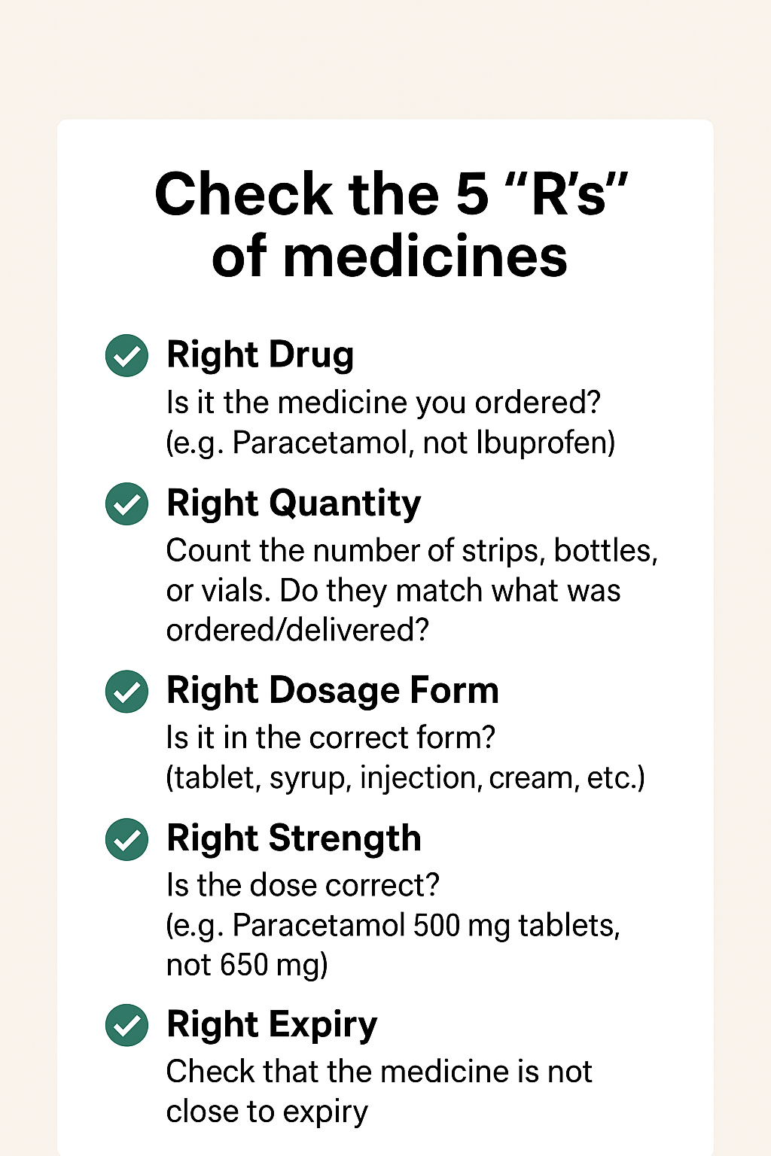
Receiving of Medicines
When receiving the medicine stock at the facility check for:
Right Drugs
Right quantity
Right Dosages form
Right Strengths.
Right Expiry
There is no visible evidence of damage or tampering.
There are no defects (check for spots, pits, chips, breaks, uneven edges, cracks, embedded or adherent foreign matter).
Parenteral solutions are clear.
No leaking containers (bottles, vials etc.).
The issuing store should be notified of any discrepancies, including missing items, incorrect items (not ordered), incorrect quantities or damaged, broken or poor-quality items.

Slide 5
Factors contributing to inaccurate stock records
High volume, repetitious entries
Drugs names and descriptions are similar
Duplicate entries for receipts or issues
Spoiled or junk stock destroyed but not written off
Theft produces inaccurate records, except when deliberately altered to conceal the theft
Physical count rarely or never taken, or records not reconciled after stock count

Slide 6
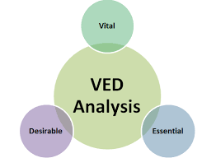

Inventory Control Tools and Techniques
Inventory control tools and techniques are methods used to ensure that stock (medicines, consumables, or other goods) is available in the right quantity, at the right time, and at the right place without overstocking or stock-outs. They help balance availability, cost, and efficiency.
Different inventory control tools used for managing and monitoring inventory:
Stock Registers & Bin cards
Stock Ledger / Daily Stock Statement
Physical Stock Verification
FEFO
Different inventory control techniques used to regulate stock levels are:
VED Analysis
FSN Analysis

Slide 7
Maintain Proper Inventory Records
Bin Card:
Simple, heavy weight cards
Kept for each item in stock room
Stock Book (Register)
Contains listing of all items in stock room
Updated monthly after physical count
Uses information from stock cards
May be electronic or paper for monthly stock management
Format of Bin Card
Drug Name ………………
Date | Medicine Came From or Dispense To | Batch No. | Expiry Date | Receipt | Issue | Balance | Signature
Date of receipt or issue | Name of supplier/Patient |  | DD/MM/YYY | No. of units received in the stock | No. of units issued | No. of units left in the stock | Person who record the movement

Slide 8

Physical Verification of the Stock
Physical inventory: Physically counting the stock that the total number of units of each health commodity in a drug store at any given time
Stock on hand can be gathered from Stock keeping records (stock register) and e - LMIS (e-Aushadhi).
Why it is important:-
It is important to carry out stock counts, both for reordering purposes and for determining the inventory value.
It should be done Periodically.
Assess the stock status
Stock on hand
(quantity we have now)
Physical counting/stock register/e-aushadhi
Month of stock
(How long the supply with last)
Average monthly consumption of that particular product
Consumption records

Slide 9
FEFO (First Expiry, First Out)
A stock rotation principle where medicines and consumables with the earliest expiry date are issued/used first, regardless of the date of receipt.
Ensures timely use of medicines before expiry.
Prevents wastage of drugs and consumables.
Aligns with quality assurance in patient care.
Should be followed during storage and distribution.
Example:
Medicine | Batch No. | Expiry Date | Action (as per FEFO)
Paracetamol 500 mg | B1 | Nov 2025 | Issue first
Paracetamol 500 mg | B2 | Feb 2026 | Issue after B1
Paracetamol 500 mg | B3 | Jul 2026 | Issue after B2

Slide 10
VED (Vital, Essential, Desirable) analysis
In this analysis medicines are classified by their importance to the facility’s operations
Vital (V): Items essential for patient survival and uninterrupted services.
  E.g.- Adrenaline injection, Atropine injection, Oxygen gas, Snake venom antiserum, Anti-rabies vaccine, Insulin injection etc.
  Their absence causes major disruptions
Essential (E): Important items, but alternatives or substitutes may be available.
  E.g.:- Paracetamol, Ibuprofen, Amoxicillin, ORS, Hydrocortisone, Diazepam etc.
  Their absence affects service but is not life-threatening.
Desirable (D): Items whose shortage or absence does not critically affect hospital operations.
  E.g:- Multi-vitamin tablets, Levofloxacillin, Cefadroxil, Antacids etc.
  Their absence not critically affects service.

Slide 11
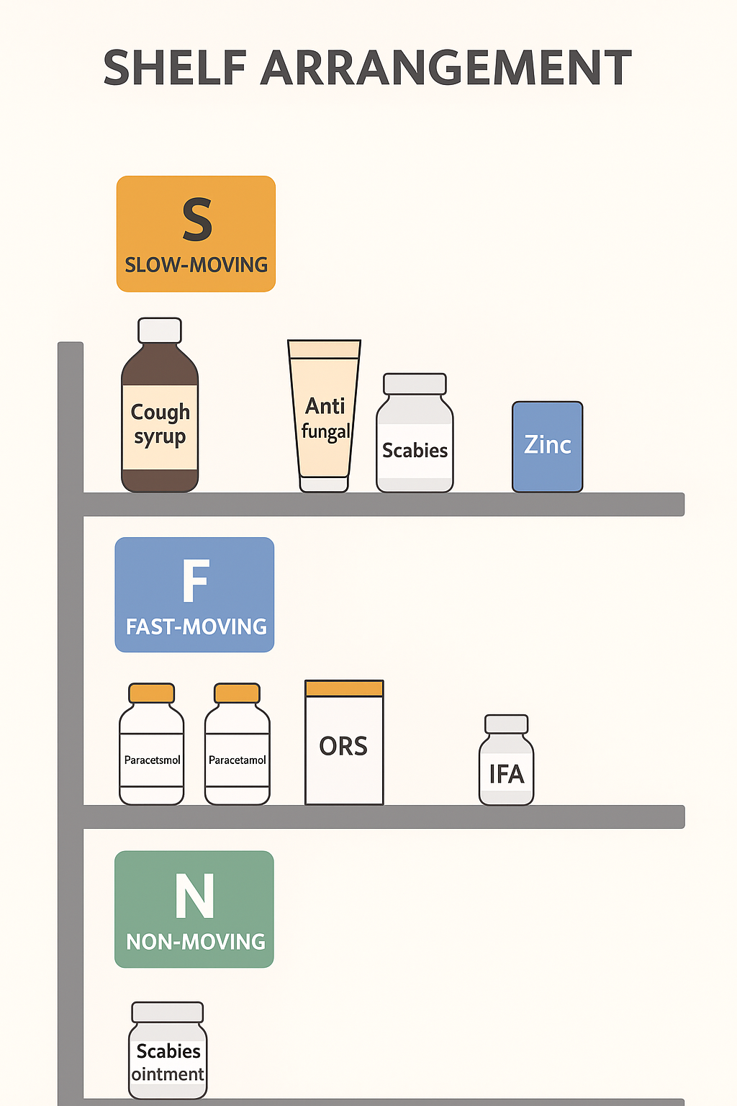
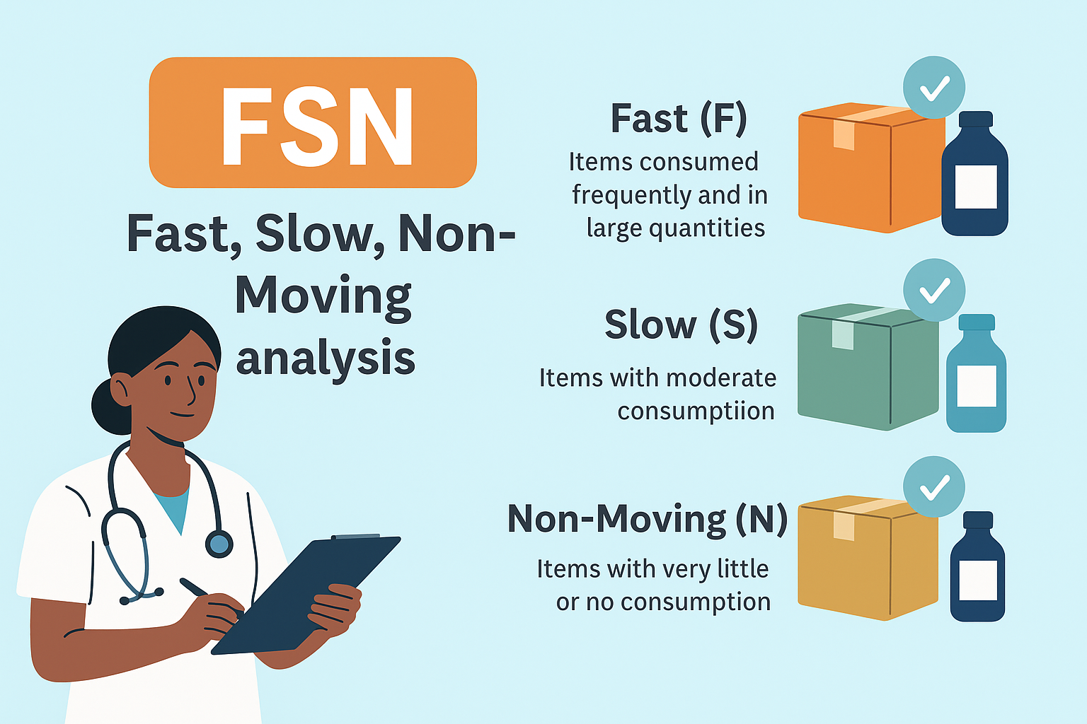
FSN (Fast, Slow, Non-Moving) Analysis
Fast (F): Items consumed frequently and in large quantities.
Maintain big safety stock
Medicines used daily or very frequently
Slow (S): Items with moderate consumption.
Maintain sufficient safety stock
Medicines used sometimes, but not every day
Non-Moving (N): Items with very little or no consumption over a defined period.
Minimum safety stock.
Medicines rarely used, or not used for month
Must be periodically reviewed to prevent expiry & obsolescence

Slide 12
FSN (Fast, Slow, Non-Moving) Analysis
Example: FSN Analysis Sheet
Medicine Name | Total number of units received | Units Consumed in Quarter (E.g. Jul–Aug) | Percentage of Total Consumption (Units Consumed / Total Units) x 100) | FSN Category | Category
Paracetamol | 2500 | 1,500 | 60% (1,500 / 2,500 x 100) | F (Fast-moving) | High usage – reorder every 2–3 weeks to avoid shortages.
Amoxicillin | 2500 | 600 | 24% (600 / 2,500 x 100) | S (Slow-moving) | Moderate usage – check stock monthly and reorder as needed.
Albendazole | 2500 | 2000 | 80% (2000 / 2,500 x 100) | F (Fast-moving) | High usage – reorder every 2–3 weeks to avoid shortages.
Levocetirizine | 2500 | 400 | 16% (400 / 2,500 x 100) | N (Non-moving) | Low usage – check for expiry and consider smaller orders or returning.
Midazolam | 2500 | 200 | 8% (200 / 2,500 x 100) | N (Non-moving) | Very low usage – avoid overstocking; consider alternative suppliers if demand rises.

Slide 13
Quantification and Demand Estimation
Average consumption adjustment that accounts for any time that the item was unavailable.
Total Estimated Demand = Average consumption + Lead Time consumption + Buffer Stock
Actual need
Lead time - The time between when the drugs are ordered and when they are available to the patient.
Buffer stock
Lead time
Reorder Level
Starting point
Safety stock/Buffer Stock - A reserve quantity of stock maintained at a health facility to ensure uninterrupted supply, prevent stock-outs during demand fluctuations or supply delays.
Safety Stock
Procurement
interval
Quantity of medicine required
Notes:
QUANTIFICATION CONCEPTS
More than you may think, if starting from considering the needs for existing patients
Total consumption in a period
A measure of how much has been used during a specific period
Average monthly consumption
A measure of how much is used in an average month
Adjusted monthly consumption
An adjustment that accounts for any time that the item is unavailable
Filling the supply pipeline
Refers to stock levels within the supply system and the number of supply points at each level that must be filled
Lead time
The time between when the drugs are ordered and when they are available to the patient
Stock on order
Any stocks that are on order and have not arrived yet must be taken into consideration when calculating needs
Safety stock
An amount of stock that is kept in reserve to allow for an item being unavailable from the supplier or having a sudden increase in demand
Adjusting for losses and program growth
Some items will be lost due to damage, spoilage, expiration, and theft. If losses are not considered in quantification and procurement, stock-outs are likely.
Number of months’ stock on hand
The number of months’ stock on hand gives an indication of whether an item is overstocked. If the number of months of stock is greater than three months’ stock for district stores or greater than two months’ stock for a health center, the item is overstocked.
The number of months of stock on hand is calculated by dividing the months of stock on hand by average monthly consumption.

Slide 14
Demand Estimation Example
Question - In an AAM Sub Health Center, medications are delivered quarterly. The total usage of Aspirin tablets in the previous quarter was 5,000 tablets over 70 working days, but Aspirin was out of stock for 20 days. The time from ordering to receiving supplies is 10 days. A safety stock of 150 tablets is kept to handle fluctuations in demand and supply. There are currently 50 tablets in stock at the time of ordering. Estimate the demand for Aspirin tablets for the upcoming quarter, which includes 80 working days.
Solution:
Average Daily Consumption (ADC) : Consumption During Last Quarter = 5,000 = 5000 = 100 Tablets
Working Days – Stock out Days 70 – 20 50
Lead Time Consumption (LTC) : Lead time x Average Daily Consumption = 10 x 100 = 1000 Tablets
Buffer Stock (BS) : 150 Tablets
Available Stock (AS) : 50 Tablets
Estimated Demand For Coming Quarter : {(ADC x Working days in the coming Quarter) + LTC + BS} – AS
{(100 x 80) + 1000 + 150} – 50 = {8000 + 1000 + 150} - 50
= 9150 – 50 = 9100 Tablets
Notes:
QUANTIFICATION CONCEPTS
More than you may think, if starting from considering the needs for existing patients
Total consumption in a period
A measure of how much has been used during a specific period
Average monthly consumption
A measure of how much is used in an average month
Adjusted monthly consumption
An adjustment that accounts for any time that the item is unavailable
Filling the supply pipeline
Refers to stock levels within the supply system and the number of supply points at each level that must be filled
Lead time
The time between when the drugs are ordered and when they are available to the patient
Stock on order
Any stocks that are on order and have not arrived yet must be taken into consideration when calculating needs
Safety stock
An amount of stock that is kept in reserve to allow for an item being unavailable from the supplier or having a sudden increase in demand
Adjusting for losses and program growth
Some items will be lost due to damage, spoilage, expiration, and theft. If losses are not considered in quantification and procurement, stock-outs are likely.
Number of months’ stock on hand
The number of months’ stock on hand gives an indication of whether an item is overstocked. If the number of months of stock is greater than three months’ stock for district stores or greater than two months’ stock for a health center, the item is overstocked.
The number of months of stock on hand is calculated by dividing the months of stock on hand by average monthly consumption.

Slide 15
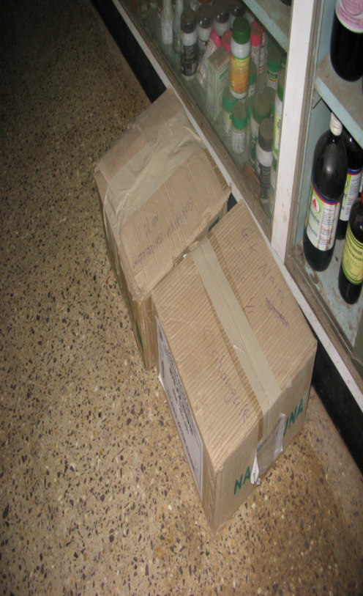
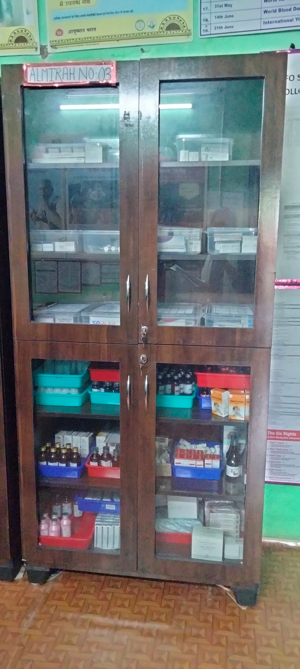

Proper storage of medicines
There should be specified place to store medicines in the facility.
Store the supplies in Heavy Duty shelves, with heavy items at lower shelves/racks.
Do not place any boxes on the floor and near the wall
Use Refrigerator to store heat sensitive drugs and vaccines.
Do not open refrigerator unnecessarily.
Record the temperature and ensure enough space around the refrigerator for free air movement.
Look Alike and Sound alike medicines are stored separately in patient care area and pharmacy
Store near expiry/expired drugs in a separate area/shelve.
Drugs and consumables are stored away from water and heat sources, direct sunlight
Fragile items are not stored at the edges of the shelves.
High alert medicines are stored separately away from the patient care area.
No loose drugs , strips lying in open.
Oxygen Cylinders are properly labeled, and pressure is updated regularly.
X

Slide 16
Terminologies in Inventory Control
Lead Time:- Lead time in inventory management is the total time elapsed between placing an order and receiving the stock ready for use or sale. It includes all the steps involved from the moment an order is confirmed until the goods are delivered and available in inventory.
Invoice Date
Payment Date
Order Date
Delivery Date
Lead Time
Average Daily Consumption:- Refers to the typical quantity of an item used or consumed per day over a defined period. It helps in estimating regular usage and planning replenishment.
Maximum Daily Consumption:- Represents the highest quantity of an item used or consumed on any single day within the reviewed period.

Slide 17
Buffer Stock Management
Assess Consumption Trends:
Review the past 3-6 months consumption of essential medicine & consumable
Calculate average monthly consumption (AMC) for each item.
Define Buffer Stock Level:
Buffer stock is usually 1 months of AMC.
Example: If average use of paracetamol = 300 tablets/month and lead time = 1 month, keep 600 tablets (1 month working stock + 1 month buffer)
Set Re Order Level (ROL):
ROL = (AMC × Lead time) + Buffer stock.
Indent supplies when stock falls to this level.
Maintain Accurate Records:
Use stock registers / drug inventory registers or digital tools if available (e.g., e-Aushadhi, DVDMS).
Update every issue/receipt immediately.
Regular Monitoring:
Weekly or bi-weekly physical stock check to avoid expiry and pilferage.
Rotate stock using FEFO (First Expiry, First Out) principle.

Slide 18
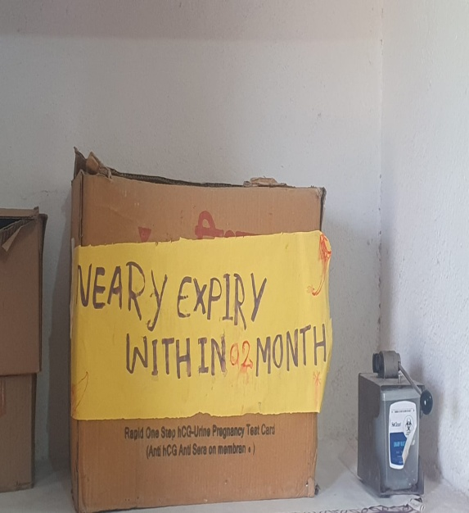
Expiry/Near Expiry Stock Management
Bin Card
Note the expiry date of each batch while entering stock in the drug register / inventory software.
Apply FEFO Principle (First Expiry, First Out)
Always issue medicines with the nearest expiry first, even if a newer batch is available.
Arrange stock physically on shelves accordingly (older expiry in front, newer at the back).
Routine Monitoring
Conduct monthly stock review to identify medicines nearing expiry (within 6 months).
Redistribution of Near-Expiry Drugs
Coordinate with PHC/CHC to redistribute medicines that may not be consumed before expiry.
Ensure transfer at least 3–6 months before expiry.
Segregation of Expired/Near Expiry Stock
Keep expired/near expiry medicines in a separate box, clearly labeled “Expired – Not for Use”
or “Near Expiry Drugs”.
Documentation & Reporting
Maintain an “Expired Stock Register” recording item name, batch no., expiry date, and quantity.
Safe Disposal
Dispose off expired drugs as per guideline prescribed for disposal of drugs

Slide 19
Calculate Stock Level
Reorder Level (ROL): The stock level at which a new order should be placed to replenish the stock before it runs out.
  Reorder Level (ROL) = {Maximum Daily Consumption × Maximum Lead Time (in days)} + Safety Stock
Minimum Stock Level : The minimum quantity of a drug that must be available in stock to avoid stock-out situations.
  Minimum Stock Level = ROL – (Average Daily Consumption × Average Lead Time)
Buffer Stock (Safety Stock): The extra stock kept to prevent stock-out due to unforeseen delays or increased usage.
  Buffer Stock = (Maximum Daily Consumption – Average Daily Consumption)× Average Lead Time

Slide 20
Exercise- Consumption Pattern of 5 Medicines are given for 5 Medicines
Question - If average lead time is 1 day and maximum lead time is 3 Days, calculate Total Consumption, Average Daily Consumption, Maximum daily consumption, Reorder Level, Minimum stock level and no. of days of buffer stock to be kept of each of these medicines.
Name of Medicines | Safety Stock | Day-1 | Day-2 | Day-3 | Day-4 | Day-5 | Day-6 | Day-7 | Day-8 | Day-9 | Day-10
Paracetamol | 180 | 100 | 120 | 130 | 112 | 115 | 125 | 130 | 140 | 115 | 120
Amoxicillin | 300 | 115 | 200 | 250 | 270 | 280 | 300 | 320 | 117 | 340 | 290
Metformin | 450 | 300 | 340 | 400 | 420 | 430 | 440 | 450 | 500 | 520 | 530
Atenolol | 450 | 320 | 330 | 380 | 410 | 440 | 450 | 460 | 400 | 600 | 490
Diclofenac | 200 | 300 | 320 | 120 | 115 | 118 | 120 | 113 | 230 | 240 | 250

Slide 21
Exercise- Consumption Pattern of 5 Medicines are given for 5 Medicines
As mentioned in the Question We have to calculate:
Total Consumption
Average Daily Consumption
Maximum Daily Consumption
Reorder Level
Minimum Stock Level
Number of Days’ Buffer Stock to be Maintained
Solution: To understand the calculation for points “a to f”, let’s take an example of Paracetamol to proceed further.
Total Consumption = Sum of Consumption (from Day 1 to Day 10 as mentioned in the Table)
= 100 + 120 + 130 + 112 + 115 + 125 + 130 + 140 + 115 + 120
= 1207 Tablets
Average Daily Consumption: Total Consumption = 1207 = 120.7 Tablets
Total no. of Days 10

Slide 22
Exercise- Consumption Pattern of 5 Medicines are given for 5 Medicines
Solution: To understand the calculation for points “a to f”, let’s take an example of Paracetamol to proceed further.
Maximum Daily Consumption: Highest consumption entry in the data of a particular medicine over the total number of days for which it is analyzed.
For Example, Here we are calculating the consumption for Paracetamol (as mentioned earlier) based on the data provided in the question.
  The Maximum Daily Consumption of Paracetamol was on Day 8 = 140 Tablets
Reorder Level: {Maximum Daily Consumption × Maximum Lead Time (in days)} + Safety Stock
{140 x 3} + 180 = 420 + 180
= 600 Tablets
Minimum Stock Level: Reorder Level – (Average Daily Consumption × Average Lead Time)
600 – (120.7 x 1) = 600 – 120.7
= 479.3 Tablets
Number of Days’ Buffer Stock to be Maintained: (Maximum Daily Consumption – Average Daily Consumption) x Average Lead Time
(140 – 120.7) x 1 = 20.7 x 1
= 20.7 Days

Slide 23
Answer
Name of Medicines | Total Consumption in a Month | Average Daily Consumption | Maximum Daily Consumption | Reorder Level | Minimum Stock Level | Buffer Stock
Paracetamol | 1207 | 120.7 | 140 | 600 | 479.3 | 20.7
Amoxicillin | 2482 | 248.2 | 340 | 1320 | 1071.8 | 91.8
Metformin | 4330 | 433 | 530 | 2040 | 1607 | 97
Atenolol | 4280 | 428 | 600 | 2250 | 1822 | 172
Diclofenac | 1926 | 192.6 | 320 | 1160 | 967.4 | 127.4

Slide 24
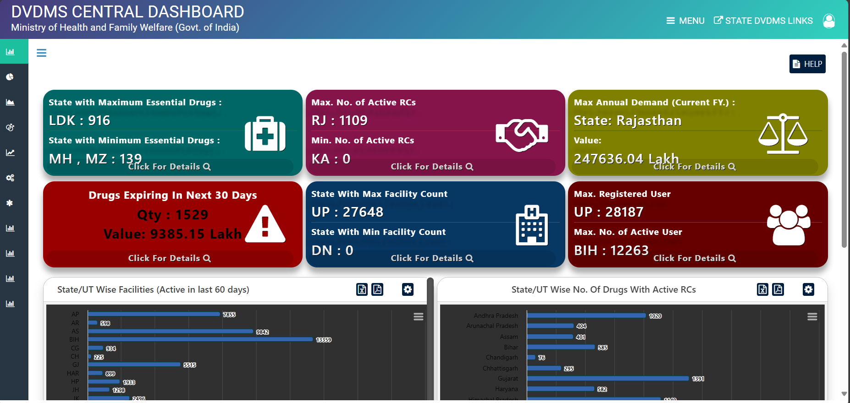
E-Monitoring of Inventory
Indenting and stock monitoring of medicines can be efficiently carried out through the DVDMS mobile application. This application allows healthcare facilities to:
Raise indents for medicines and consumables based on their requirements.
Track stock levels in real time, ensuring that shortages or overstocking are minimized.
Monitor consumption patterns to improve planning and utilization of resources.
Facilitate transparency by digitally recording all stock movements (receipt, issue, return, and consumption).
Enable quick decision-making at the facility level by providing instant visibility of available stock.
Indenting by using mobile application
At the National level: The overall stock position across all states and facilities is monitored through the DVDMS Central Dashboard, which provides a comprehensive and real-time overview of medicine availability throughout the country.

Slide 25

THANK YOU

